Slide 1
Evaluat-inator
GNR 652: Machine Learning for Remote Sensing - I
Course Project under Prof Biplab Banerjee
Notes:
Evaluates ratings given by users to new movies

Slide 2
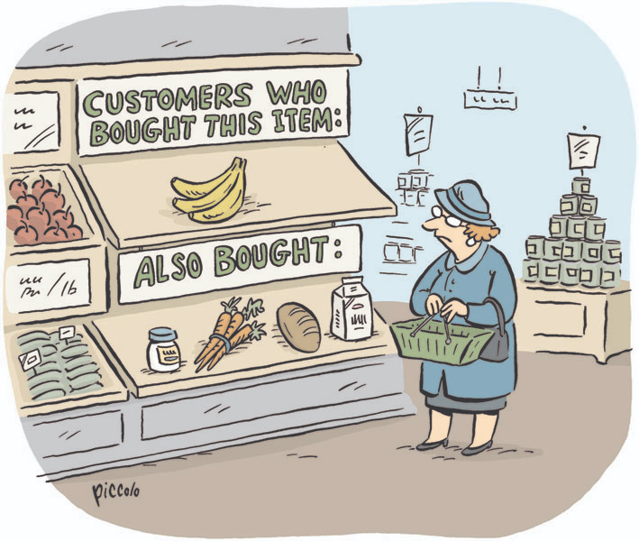
Avyakta Wrat 180070010
Meeta Malviya 180070034
Devank Rajvanshi 18D100009
Recommendation Engines
The Team
Notes:
Instead of choosing from a huge diversity of choice, recommendation engines give us ease, and better user experience.
The image shows a non-digital version of recommendation engine

Slide 3
About
Recommendation Systems play a major role in today’s business needs. With a better recommendation, a business is more likely to lure its customers into buying a product of their liking, which will accrue to a businesses’ profits and make it more customer oriented.
The motivation of the project is not to dig into the complexity but rather expose ourselves to a wider domain of mathematics, machine learning and deep learning while building a movie recommendation engine from scratch.
Notes:
As the business needs are accelerating, there is an increased dependence on extracting meaningful information from humongous amount of raw data to drive business solutions. The same is true for digital recommendation systems which are becoming a norm for consumer industries such as books, music, clothing, movies, news articles, places, utilities, etc. These systems collect information from the users to improve the future suggestions

Slide 4
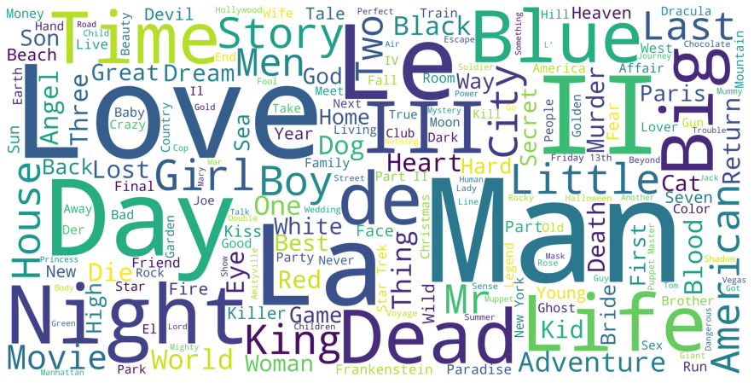
Datasets
Movie Lens is a collection of movie ratings. It contains around 1M ratings given by around 6k users on around 4k movies. The following dataframes were present:
Movies : contains 3883 movies with moviesID, title and genres.
Users : contains 6040 users with userID, gender, zip code, age.
Ratings : contains 1000209 ratings with their userID, movieID and ratings.
Notes:
Word Cloud was built using Python code from the movie names.

Slide 5
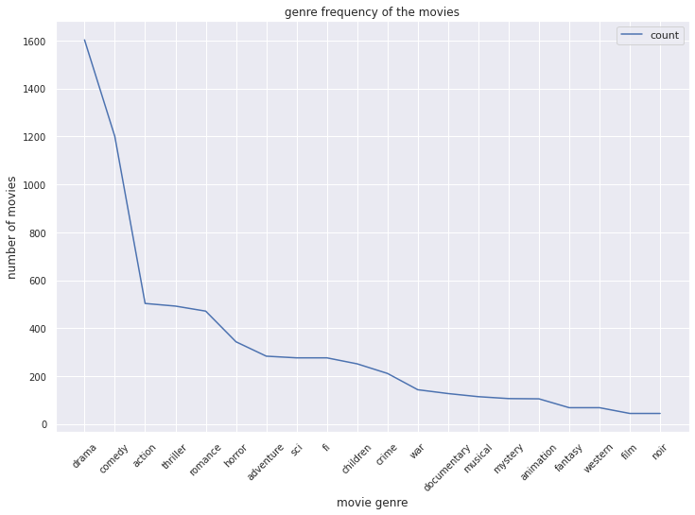
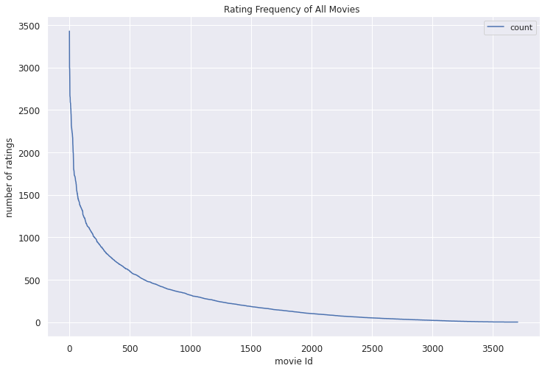
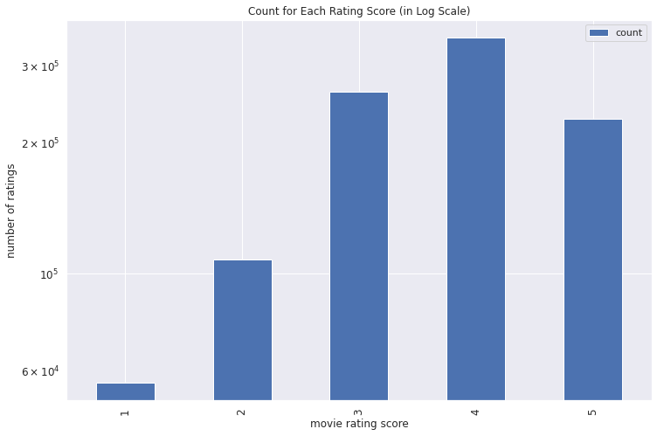
Exploratory Data Analysis (EDA)
We observe that users give 3 or 4 more than any other ratings.
There are few movies only which are highly rated. The data is highly skewed.

Slide 6
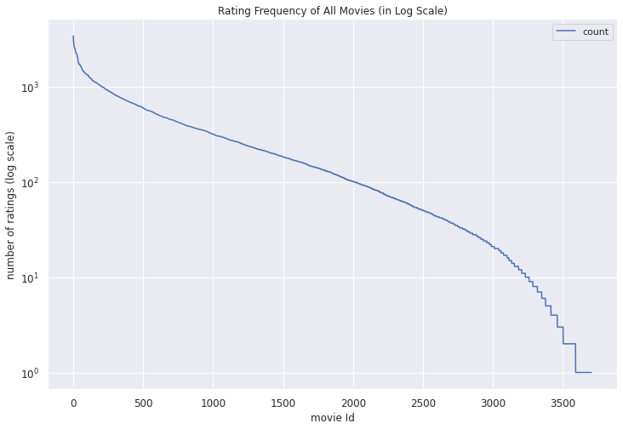
There are only 600-700 movies out of 4k movies that are rated more than 500 times.
There are 5 genre which have more than 400 movies rated, and about 11 genres with less than 200 movies. Which shows that few genres are more preferred than others.

Slide 7
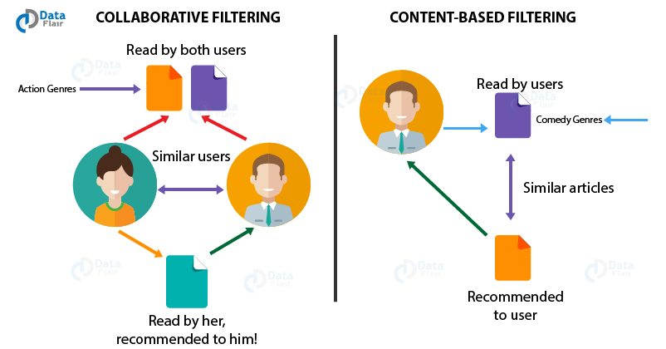
Types of Recommendation systems
The system executes a model-building stage by finding the similarity between all pairs of items.
The system executes a recommendation stage. It uses the most similar items to a user's already-rated items to generate a list of recommendations.

Slide 8
Data Pre-processing
A user-movie matrix containing the ratings given by user to each movie was created from the ratings.dat dataset. Users as rows and movies as columns. The empty fields were filled with 0.
Outliers were Removed from movies dataframe. Those movies which had less than 50 ratings were removed and subsequently those ratings which were given to the unpopular movies were removed.
Outliers were removed from ratings data frame. Ratings given by non-active users, ie those users who had given less than 50 ratings were removed for better performance of the model.

Slide 9
Overview
We have implemented the following five models:
Content Based and Collaborative Filtering using Similarity Matrices
Singular Value Decomposition (Matrix Factorization)
KNN Clustering Algorithm
Auto-Encoders (Deep Learning)
Embeddings (Deep Learning)

Slide 10
Similarity Matrices
Cosine Similarity
Cosine of the angle between the feature vector
Used on content-based recommendation as each dimension was significant
Pearson Similarity
Similar to cosine but uses only those dimensions that are common to the two vectors
Gave a better performance on user-user collaborative filtering

Slide 11
Content Based Collaborative Filtering
Recommendation based on similarity between movies’ genres
Top ‘n’ similarity scores were given as output
No proper evaluation was possible as ratings were not predicted
Recommendation based on similarity between users’ previous ratings
Top ‘n’ rated movies in the result was given as output
Model was evaluated by splitting the data into train and test
NOTE: No Optimization was done here. This was a pure Mathematical concept where similarity scores were used to evaluate recommended movies.
RMSE of around 3 was reported on unseen data, which was quite high and led us to look for better models

Slide 12
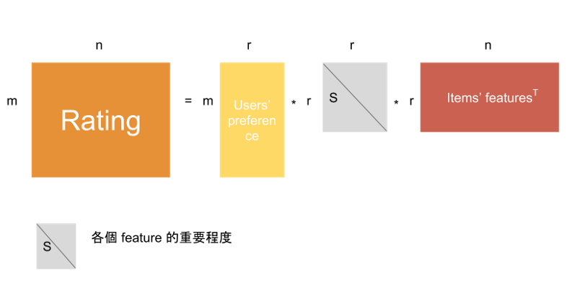
Singular Value Decomposition
- Collaborative Filtering Technique
Surprise Library was used to build an effective recommendation system
Predicted ratings of every movie by every user is stored in the matrix reconstructed from SVD
This model showed a better performance with a rmse of less than 1 on unseen data, implying predicted ratings differed by less than 1 than the provided dataset

Slide 13
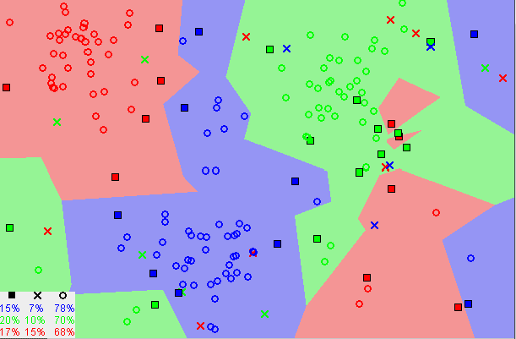
KNN based item-item collaborative filtering
The k-nearest neighbors (KNN) algorithm is a simple, easy-to-implement supervised machine learning algorithm. KNN captures the idea of similarity.
In KNN classification, the output is a class membership. An object is classified by a plurality vote of its neighbors, with the object being assigned to the class most common among its k nearest neighbors

Slide 14
Steps to build KNN based recommendation System
The data is read in data frame as ratings, users and movies. These dfs are processed as described in EDA section
The processed data is used to create a matrix(namely movie_user_mat ) between moviesId and userId as rows and columns respectively. The values of the cell of matrix( movie_user_mat[i, j] ) is the rating given by j^{th} user on i^{th} movie. This matrix is transformed into scipy sparse matrix for easy computation.
A mapper(namely movie_to_idx ) is a dictionary which is created, that maps movie to it's index according to movies dataframe.
The matrix is fed into NearestNeighbors model of sklearn. 'Cosine' similarity metric is used with brute algorithm.

Slide 15
Steps to build KNN based recommendation System
Fuzzy_matching function takes in favorite movie as input and gives out index of most similar movie listed in mapper. The similarity is calculated via fuzz ratio.
In the function make_recommendation the data(i.e. the movie_user_mat) is fit in knn model, it then finds n nearest neighbours of data[idx], where idx given out by Fuzzy_matching function for favorite movie.
The distance is sorted in top n neighbours with maximum distance( i.e. minimum angle as cosine similarity is used) is printed with movies name mapped via reverse mapping of movieID to movie.

Slide 16
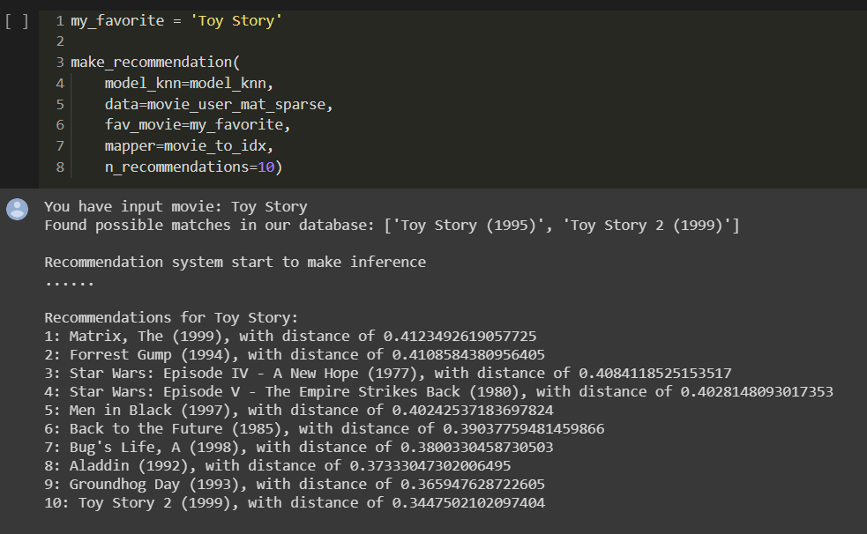
Sample output of KNN model

Slide 17
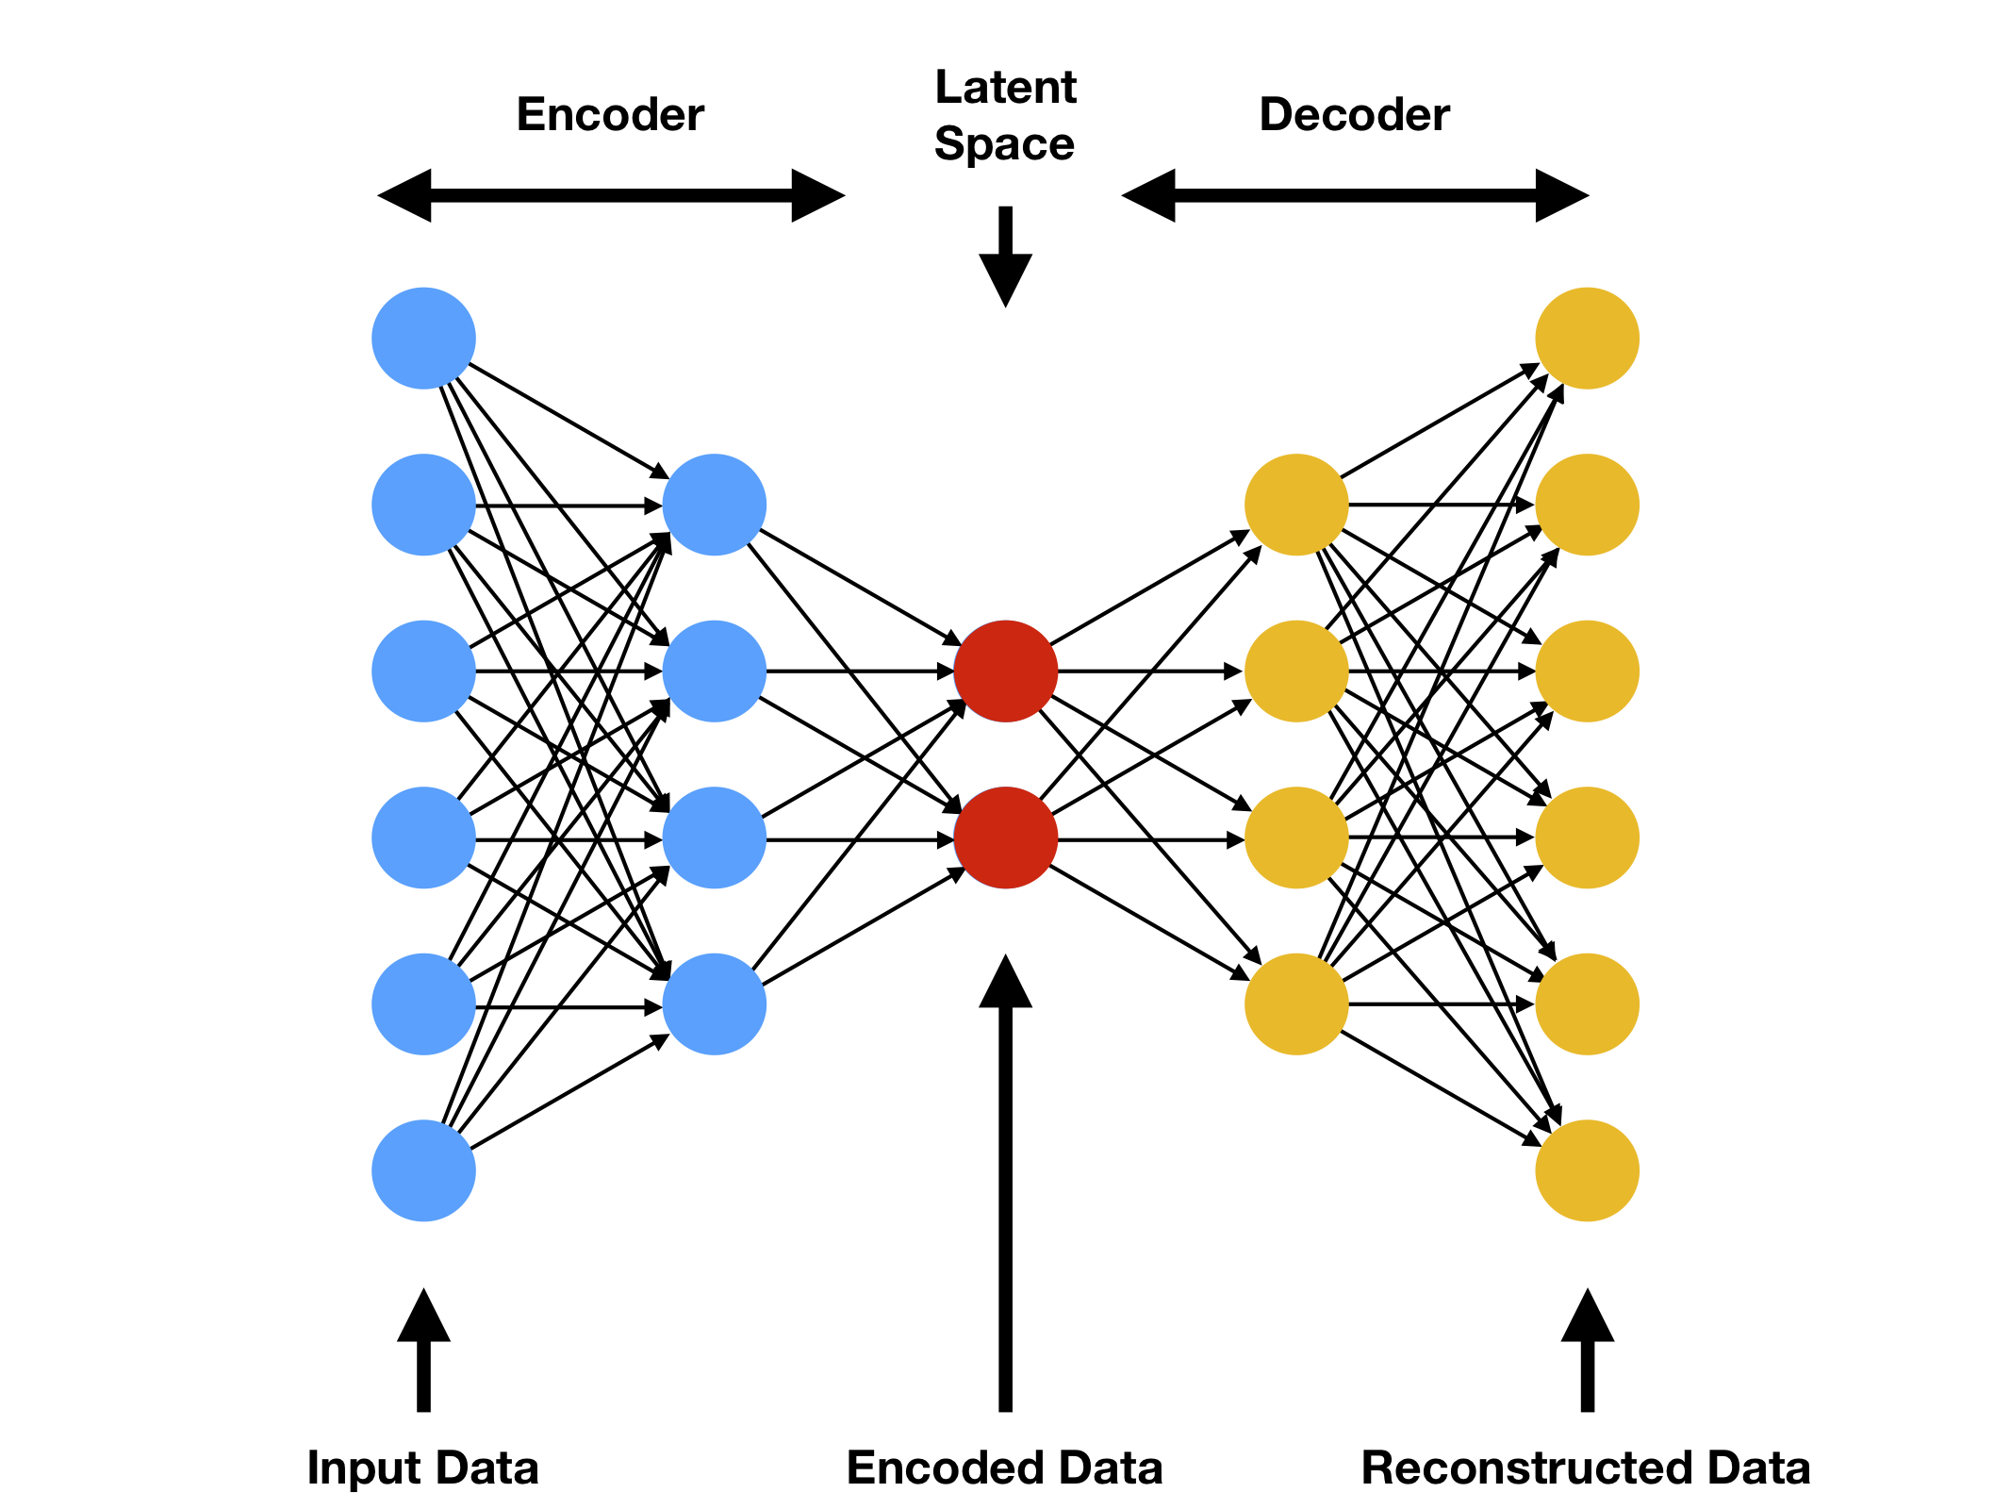
Auto-Encoders
Deep Learning
Collaborative Filtering

Slide 18
What are Auto-Encoders?
Artificial Neural Network characterized by a encoding and decoding layer
Same number of input and output neurons
Idea is to train a neural network to map the inputs to outputs, that are same as inputs.
In process, we expect autoencoder to learn the most salient features and recommend based on them.
The Architecture: 3 hidden Layers with 20, 10 and 20 neurons in each

Slide 19
Training
Design of User-movie matrix such that rows are various users input
Computed output from the neural network has ratings for unrated movies
Loss computation (MSE) does not count for unrated movies
For this output ratings for unrated movies is set to 0, MSE calculated and multiplied by a correcting factor
Optimization is done to get MSE < 1 on both train and test set

Slide 20
Embeddings - Deep Learning
This is a content based filtering approach.
Maps the movie ids to a latent space to form embeddings and then build a multi-layer perceptron classifier to learn predicting the movie ratings.
The intuition behind using embeddings is that each component of the embedding can be thought of as a higher level representation of movie , for eg: different genres and their combinations.
We build a model for each user. The model will learn to predict the ratings that the user would give to a movie.
Whenever we want to recommend a new movie to an existing user, we can pass that movie id to the user's model to estimate the rating. If that rating is high, we can recommend that movie to the user.

Slide 21
Steps to build Embedding Model
A user is selected and the all the ratings given by him are extracted.
Each of these movie Ids is passed in to the model to get 5 output probabilities for each of the rating value of 1 to 5.
Cross Entropy loss was used as an optimization criterion and Adam optimizer with a learning rate of 0.0001 and weight decay of 1e-6 is used.
Backpropagation was used to compute the gradients and update the parameters.
The model was trained for 200 epochs.
PyTorch was used to train the model.

Slide 22
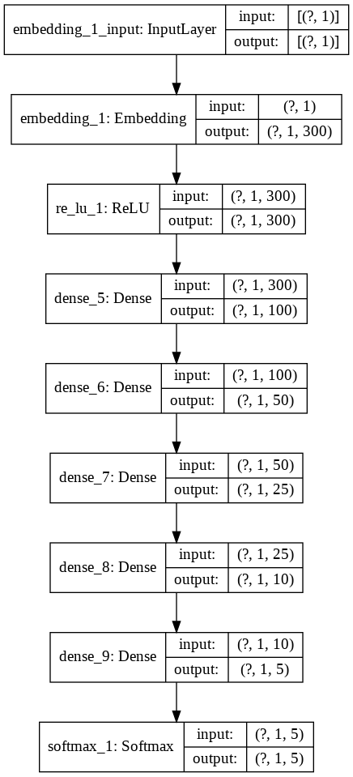
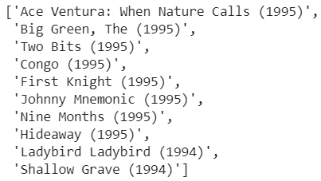
Model structure
Sample output of Embedding model for user[idx=1]

Slide 23
Conclusion
Drawing Comparisons between collaborative filtering models

Slide 24
User-user Based
AutoEncoder | SVD Implementation
Pros-
Developers make more user interested products from feedback given.
The model can help users discover new interests and recommendations made are more bold.
Cons-
Recommender fails to recommend new or non active users because the model needs to train to understand taste of the user.
Uses much more resources and computation power than item-item collaborative filtering and adding a new user is expensive since it requires to update all similarities between users

Slide 25
Item-item Based
KNN | Embeddings Deep Learning
Pros-
Requires less computation power and resources to implement.
The model can help users discover new interests.
Cons-
Popularity bias: recommender is prone to recommender popular items.
Recommender fails to recommend new or less-known items because items have either none or very little interactions

Slide 26
Contributions
Avyakta Wrat 180070010
Content and collaborative Filtering using Matrices
Singular Value Decomposition
Ipsit Mantri 180070032 (dropped the course)
Embeddings
Meeta Malviya 180070034
Exploratory Data Analysis
K Nearest Neighbours
Devank Rajvanshi 18D100009
AutoEncoders
All the team members were actively involved in each area and have helped each other out.

Slide 27
References
https://github.com/avyaktawrat/Evaluat-inator
For exact results, figures and inferences, check the report(pdf) of our project. It’s in the same directory as this presentation.
Recommendation systems are supposed to be unsupervised learning, the results obtained are by dividing the known ratings into train and test. However, this isn’t the best way to test a recommendation engine as the new observed ratings cannot be evaluated.

Slide 28
Thank you

